Slide 1
JM-IDENTITY
Project Mentor
Dr. Sunil Rawat
Project Members
Shahnawaz
Saquib Naseem
Shakib
Vishwadev pratap singh

Slide 2
Contents
1. Introduction
1.1) Motivation
1.2) Background
1.3) Contribution
What ?
Why?
2. Analysis
2.1) Survey
2.2) Interview
2.3) Analysis of Existing Document
2.4) Use Case
2.5) DFD (Data Flow Diagram)
2.6) ER-Diagram
3. Structure
3.1) Android App Guard
3.2) Android App Admin
3.3) Web App for Admin

Slide 3
INTRODUCTION
1
To develop any software, software engineer use many tools like flow chart, UML (unified modeling language), debugging tools, compiler, text editor and the database.
We will design our software (minor project) with the help of all the above tools and used the concept of SDLC.
According SDLC first we will collect the requirement of the software, define that requirement and after defining the requirement, we will design our software.
After implementing and testing, we can easily go for the deployment.
Once JM-Identity is developed no outsider would be allowed to enter in our University

Slide 4
MOTIVATION
1.1
Many students face difficulty while entering in the university when they forget their ID card with them.
In addition, many outsiders enter in the university causes trouble and destroy JMI property.
we wanted to develop a software that give relaxation to those students who forget their ID card and
provide security not to allow externals in the university.

Slide 5
BACKGROUND
1.2
We use android to develop our project, which included XML, and JAVA(core +advanced).
We will use Firebase database to store and retrieve data of the students.
To verify Students Guard use either ask their Student ID or Scan their ID.

Slide 6
CONTRIBUTION
1.3
Increase the current security of Jamia Millia Islamia
Give relaxation to students.
Unauthorised entry will be prohibited.
Our Application will also count the number of student who currently in the university.
Our application will also check current status of each student whether he is active or not.

Slide 7
WHAT?
Our project name is JM-IDENTITY and it is going to be an android application as well as web application for admin.
This application will increase the current security of the university
This android application will particularly for guards.
This application will also count the total number of student currently present in the university.
when a student enter in the university they will be in active state and when they exit from the university their status is set to deactivate state.
This will also store the information of number of students entering from each gates.

Slide 8
WHY ?
To enhance the security at the University gates.
To reduce problem faced by the students.
For the purpose of eliminate the entry of multiple student by using same ID-card.
For restricting false entry.

Slide 9
ANALYSIS
2

Slide 10
SURVEY
2.1
it will guide direct and co-ordinate the task required initiating our work successfully and properly.
A clear definition of the decision you need to make.
The amount of uncertainty will also be reduced by the survey.
For survey planning , me and my team visited our campus and discussed the plan of our project with so many students and take their views related to our project.
The response of students and guards are unexpected

Slide 11
INTERVIEW
2.2
What are the problems you faced on the daily basis?
What do you like in the current system?
What you want to improve in the entry pass system?

Slide 12
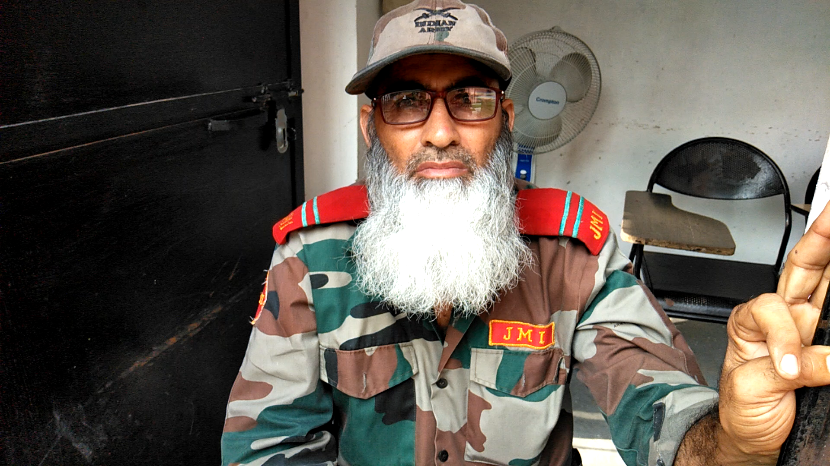
We took the interview of guard to know about our application. He told about our application that is good and totally meant for security purpose of JMI.
2.2.1

Slide 13
Analysis of Existing Document
2.3
Almost all the photos at the ID card are blur so person cannot be properly recognized.
Secondly, if the student forgot to bring their ID card they have no evidence to prove that, he/she be the student of the university.
No proper checking id-card validity
Multiple entry with the use of same ID card.

Slide 14
USE CASE VIEW
2.4
LOGIN
CURD
Admin
Data entry clerk
Maintain Data Base
Register new gaurd
Registre new Student
Update/Delete Students/Guards
Through Android app and web application
Reset System
Account management
Look over the entire web and android
application.
Administrator
Verification
Varify Students
Guard

Slide 15
Data Flow Diagram(DFD)
2.5
Register Id & Password
Administrator
Login
Register Id & Password
Register Id & Password
Guard
Data Entry Clerk
Set/Reset system
Verifying Student Data
Maintain
Submit Id/Thumb Impression
Verified
Allow
Database
Verification Process
Fetch
Student
Entry

Slide 16
ER-Diagram
2.6
Faculty
S_name
S_id
C_duration
Student
C_name
Register/Maintain
Register/Maintain
M
M
Joining date
G_name
G_id
Register/Maintain
Expiry date
M
1
M
verify
1
Guards
G_no
C_name
clerk
C_id

Slide 17
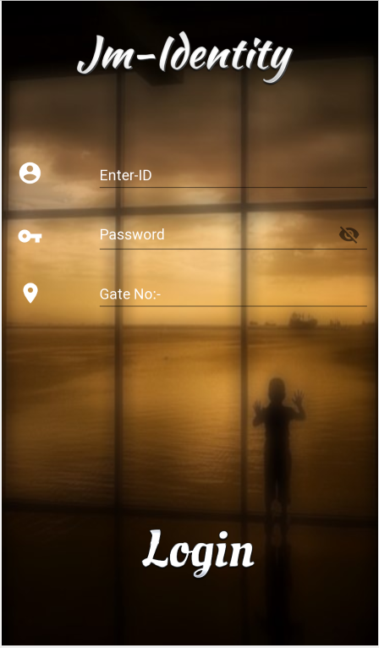
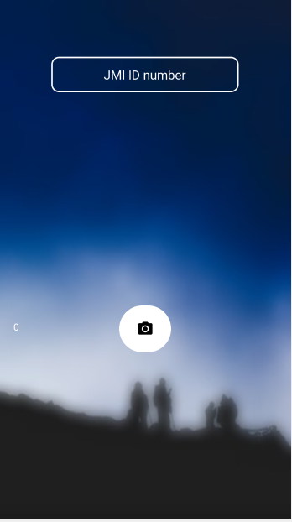
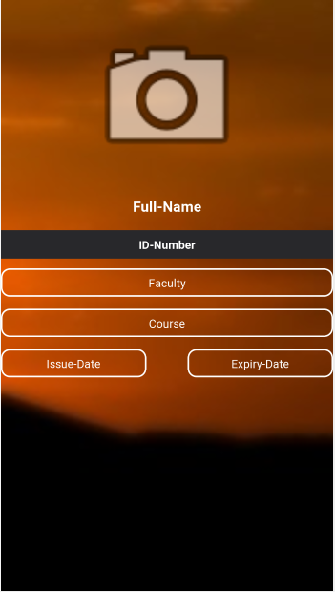
Android Application Structure (Guard)
3.1
Guard Login page
Verification page
Student Details

Slide 18
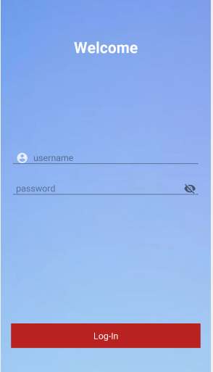
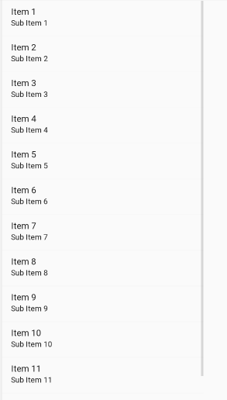
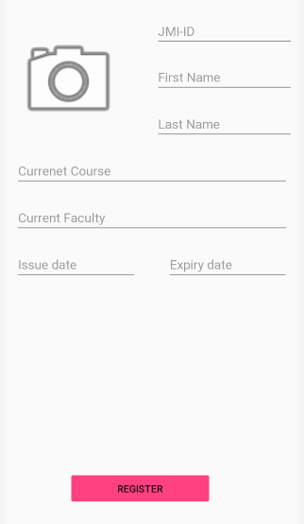
Android Application Structure (Admin)
Register student Details
Admin Login page
DashBoard

Slide 19
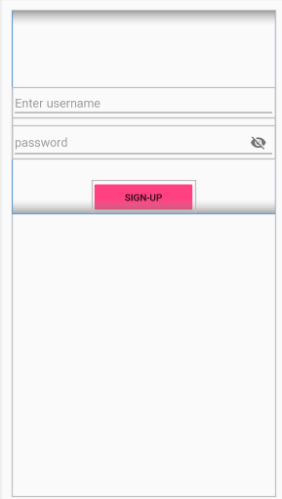
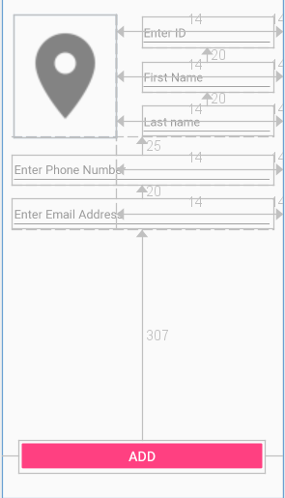
Register Admin
View List
Register gaurd

Slide 20
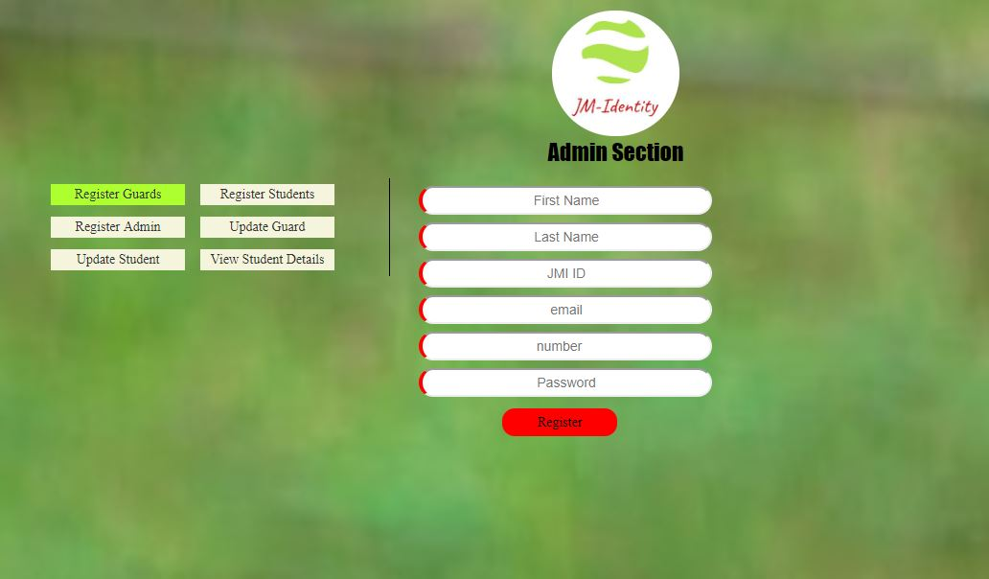
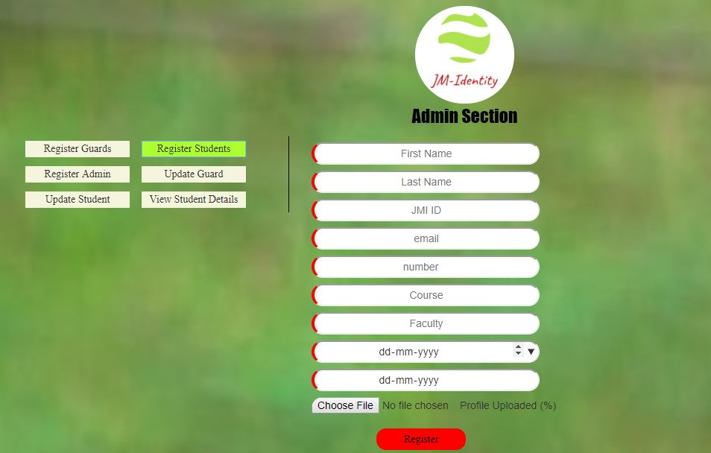
Web Application Structure (Admin)
Admin Registration
Student Registration

Slide 21
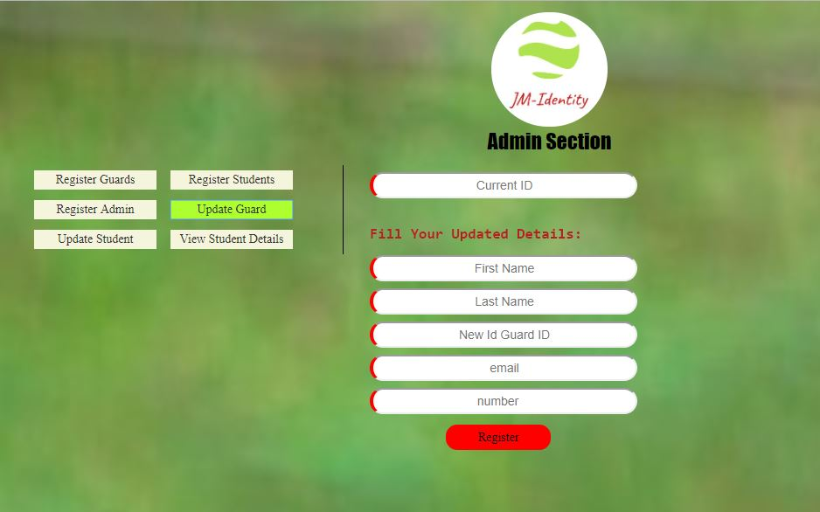
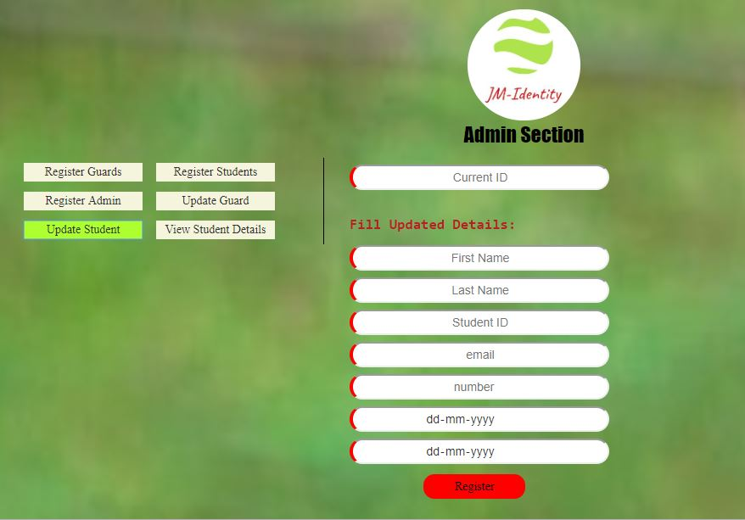
Update Guard Information
Update Student Information

Slide 22
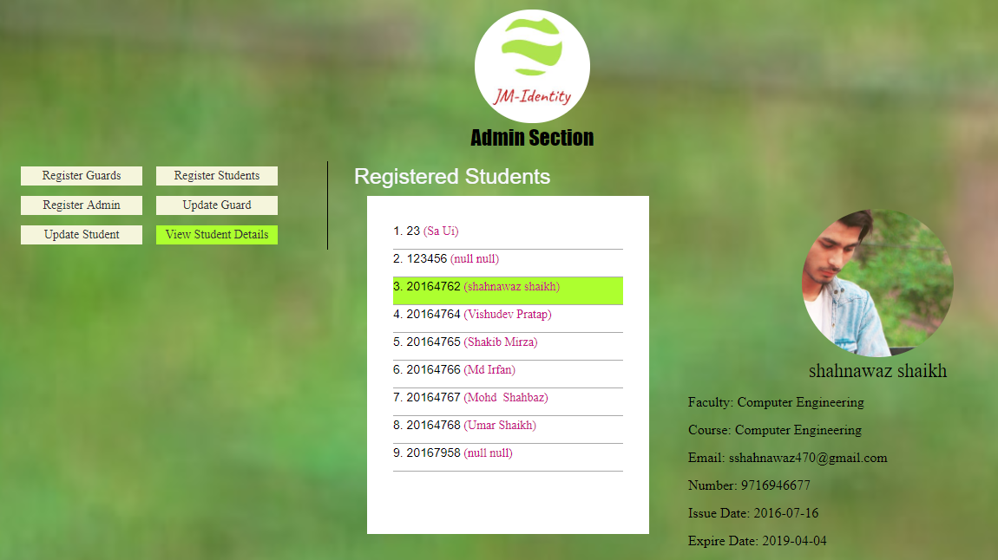
View Students Detail

Slide 23
Thank You

